Slide 1
18
Session 18 of 24
Finding structure without labels
How do we group customers or spot odd cases when nobody gave us the answers?
Jotham Martin Wambi, KLAi Professional Learning
Session 18 Finding structure without labels
1
Notes:
Until now every model had an answer column to learn from. Today the data has none. We take the Lakeside Mart orders and ask a different kind of question. Who are our customers, in groups we can describe? We will build three numbers for each loyalty customer, let k-means find the groups, and name each group in words a manager can use. We also flag unusual orders. You will have a segment table you could take into a meeting.

Slide 2
By the end of today
How the two hours run
Build recency, frequency and spend features.
Recall and warm-up
10 min
Concepts and explanation
30 min
Run k-means and choose k with evidence.
Live demonstration
25 min
Break
5 min
Describe each segment for a manager.
Guided lab
40 min
Check and wrap-up
10 min
Session 18 Finding structure without labels
2
Notes:
This is the one session with no answer column, so there's no score to chase and your own judgement does the marking. You'll build recency, frequency and spend for each loyalty customer, and see why we log and scale them. You'll run k-means and choose how many groups with the elbow and with common sense. You'll describe each segment in business words and flag unusual orders for review. The lab is mostly pandas until the clustering cells, which use scikit-learn.

Slide 3
Vocabulary
Word | Plain meaning | In a spreadsheet
Unsupervised learning | Learning with no answer column. The computer finds groups or odd rows. | Sorting and colouring a list by eye
RFM | Recency, frequency and spend: three numbers per customer. | A PivotTable per customer
Log transform | Replace each value by its logarithm to shrink a long tail. | A log scale on a chart
Standard scaling | Rewrite a column to average 0 and spread 1. | The z score
k-means | Splits rows into k groups, called clusters, around k centre points. | No equivalent. A new idea.
Elbow | The bend in the spread-against-k chart. A hint for choosing k. | No equivalent. A new idea.
PCA | Mixes many columns into two axes for a flat chart. | Best angle to photograph a statue
Anomaly | A row very different from the rest. Needs a human look. | A cell coloured red by a rule
Session 18 Finding structure without labels
3
Notes:
Eight words today. Unsupervised learning means learning with no answer column. RFM is recency, frequency and spend. A log transform squeezes a long tail, and standard scaling gives every column the same spread. k-means finds the groups. The elbow is the bend in a chart that helps you choose how many. PCA squeezes many columns into a flat picture. An anomaly is a row that looks very different and needs a human look. Most have a spreadsheet cousin, shown on the right.

Slide 4
Warm-up from Session 17
1
A model scores very well on training data and much worse on test data. What is that called?
Overfitting. It memorised the training rows instead of learning a pattern that carries over.
2
A forest says a column has high importance. What can you safely say?
The model leaned on that column. It does not prove the column causes the outcome.
Session 18 Finding structure without labels
4
Notes:
Overfitting and importance first. Two questions from Session 17.
First. A model scores very well on the training data and much worse on the test data. What is that called? Have a think.
It's overfitting. The model has memorised the training rows, so it looks clever on them and stumbles on rows it has never seen.
Second. A forest says one column has high importance. What can you safely say about that column? No rush.
You can say the model leaned on it. You cannot say it causes the outcome. Keep that care with you today, because today's models will hand us groups, and a group is only useful when we describe it plainly.

Slide 5
With an answer column and without one
Sessions 14 to 17
Today
Loans table has a default column
Orders have no segment column
Model learns to predict it
Nobody told us the groups
We score it against the known answer
We look for structure and then judge it
Without answers, there is no score to chase. A person decides whether the result is useful.
Session 18 Finding structure without labels
5
Notes:
Everything so far had an answer column. In the loan data, each loan said whether it defaulted, so the model could learn from it and we could score it afterwards.
Today's data has no such column. The orders have no segment column. Nobody went through the customers and wrote down who is a big spender or who has drifted away.
The model's job is to look for structure by itself. This is called unsupervised learning, because no answer column supervises the learning. It's what you do in Excel when you sort a customer list and colour the rows that seem to belong together, only the computer does the sorting and looking.
The verdict is the important part. With no known answer, there's no score to chase. A person has to decide whether the groups make sense for the business.

Slide 6
Keep only orders that name a customer
import pandas as pd
orders = pd.read_csv('orders.csv')
orders['order_date'] = pd.to_datetime(orders['order_date'])
loyal = orders.dropna(subset=['customer_id'])
print(len(orders), 'orders in the file')
print(len(orders) - len(loyal), 'walk-in orders left out')
print(len(loyal), 'loyalty orders kept')
print(loyal['customer_id'].nunique(), 'loyalty customers')
1
Walk-in orders have a blank customer_id. We cannot follow a person we cannot name.
2
dropna removes rows with a blank in the chosen column.
Output
30229 orders in the file
9171 walk-in orders left out
21058 loyalty orders kept
2499 loyalty customers
3
Twenty five hundred loyalty customers is our population for the day.
Session 18 Finding structure without labels
6
Notes:
Our file is the Lakeside Mart orders again. We want to group customers, so every row we use must say which customer it belongs to.
A walk-in order has a blank customer_id, because the person did not give a loyalty number. We cannot follow a person across visits if we do not know who they are. So these rows are left out of the segments. That is nine thousand one hundred and seventy one orders. Anyone reading your segments should know that walk-in shoppers are not in them.
The method that does the leaving out is dropna, with the column name inside. It removes every row that is blank in that column.
What remains is twenty one thousand and fifty eight orders from two thousand four hundred and ninety nine loyalty customers. That's the group we will segment.

Slide 7
RFM
Three numbers for each customer. Recency is days since the last order. Frequency is how many orders. Monetary value is total spend, called spend here.
In our data
In a spreadsheet
Customer C0001: last order 6 days before the end of the file, 15 orders, 969,690 UGX in total.
Three columns from a PivotTable on customer: latest date, count of orders and sum of order value.
Session 18 Finding structure without labels
7
Notes:
Most customer segments start from three numbers, and the set has a short name. RFM.
R is recency, which means how many days since the customer last ordered. F is frequency, which means how many orders they made. M is monetary value, which is how much they spent. We will simply call that spend.
Take customer C0001. Their last order was six days before the last date in our file. They made fifteen orders, and they spent nine hundred and sixty nine thousand six hundred and ninety shillings in total.
In a spreadsheet you would get these three columns from a PivotTable with the customer on the rows. Latest date, count of orders, and sum of order value. We will make the same table in pandas.

Slide 8
Build recency, frequency and spend per customer
end = loyal['order_date'].max()
rfm = loyal.groupby('customer_id').agg(
last_order=('order_date', 'max'),
frequency=('order_id', 'count'),
spend=('order_value_ugx', 'sum'))
rfm['recency'] = (end - rfm['last_order']).dt.days
rfm = rfm[['recency', 'frequency', 'spend']]
print('end date:', end.date())
rfm.head(3)
1
The end date is the last order date in the file.
2
groupby builds one row per customer. agg makes the three summaries.
Output
3
Recency is the end date minus each customer's last order, in days.
end date: 2025-12-28
recency frequency spend
customer_id
C0001 6 15 969690
C0002 119 4 107745
C0003 1 6 437465
Session 18 Finding structure without labels
8
Notes:
Building it takes one row per customer and three columns.
First we need a today. Our data stops at a certain date, so we use the last order date in the file as the end date. It is the twenty eighth of December twenty twenty five. Recency counts back from there. If we used the date on your laptop, every customer would look more lapsed each day you reopened the notebook.
Then groupby gathers the orders of each customer, and agg makes three summaries. The latest date, the count of orders, and the sum of order value.
The last two lines turn the latest date into days and keep just the three columns we want. Look at the first three rows. C0001 is six days, fifteen orders. C0002 has gone quiet for a hundred and nineteen days. We now have a table of two thousand four hundred and ninety nine customers, ready for a model.

Slide 9
Spend has a long tail, and a log squeezes it
import numpy as np
print('mean spend ', round(rfm['spend'].mean()))
print('median spend', round(rfm['spend'].median()))
print('skew before ', round(rfm['spend'].skew(), 2))
print('skew after log', round(np.log1p(rfm['spend']).skew(), 2))
Output
mean spend 399687
median spend 290090
skew before 3.09
skew after log -0.01
1
A mean far above the median is the sign of a long right tail, as in Session 3.
2
A log transform replaces each value by its logarithm. Big values shrink most.
3
A skew near zero means the tail has gone.
Session 18 Finding structure without labels
9
Notes:
Remember skew from Session 3. A few very large values drag the average to the right of the typical value.
Spend has exactly that shape. The mean is about three hundred and ninety nine thousand seven hundred shillings. The median is two hundred and ninety thousand and ninety. The skew number is three point oh nine, which is strongly right heavy. A handful of customers spend millions, and they would pull a model toward themselves.
The cure is a log transform. It replaces each number by its logarithm, a scale where each step up means multiplying by a fixed amount. Big values shrink a lot and small values shrink a little. It's the same as putting a log scale on a chart axis in Excel.
The skew after the log is almost exactly zero. We use log1p, which adds one before taking the log, so a customer with zero days since their last order does not break it.

Slide 10
Scaling puts every column on the same footing
logged = np.log1p(rfm)
print('spread of each column, raw:')
print(rfm.std().round(1))
scaled = (logged - logged.mean()) / logged.std()
print('spread of each column, logged and scaled:')
print(scaled.std().round(1))
1
Raw spread: spend is in the hundreds of thousands, frequency in single digits.
2
Subtract the column average, divide by its spread. This is standard scaling.
Output
spread of each column, raw:
recency 88.7
frequency 2.9
spend 374077.7
dtype: float64
spread of each column, logged and scaled:
recency 1.0
frequency 1.0
spend 1.0
dtype: float64
3
Now every column has a spread of 1.
Session 18 Finding structure without labels
10
Notes:
There's one more step before any grouping. k-means works by measuring distances between customers. If one column is in hundreds of thousands and another in single digits, the big one decides everything.
Look at the first printout. Spend has a spread of about three hundred and seventy four thousand. Frequency has a spread of about three. A distance between two customers would be all about spend, and orders would hardly count.
Standard scaling fixes that. For each column you subtract its average and divide by its spread. In Excel that is the z score, cell minus average, divided by STDEV. After the log and the scaling, all three columns have a spread of one, so each gets an equal voice.
Log the skewed columns first, then scale every column.

Slide 11
k-means in scikit-learn: scale, fit and label
from sklearn.preprocessing import StandardScaler
from sklearn.cluster import KMeans
X = StandardScaler().fit_transform(logged)
km = KMeans(n_clusters=4, n_init=10, random_state=42)
rfm['segment'] = km.fit_predict(X)
print(rfm['segment'].value_counts())
rfm.groupby('segment')[['recency', 'frequency', 'spend']].mean().round()
1
StandardScaler does the same scaling as the line you just wrote.
2
n_clusters is k. random_state fixes the starting guess so a rerun repeats.
3
fit_predict returns a group number for every customer.
Session 18 Finding structure without labels
11
Notes:
The model itself is ready made in scikit-learn.
StandardScaler does the scaling we just did by hand, and fit_transform gives back a clean table of numbers called X. You will see the same two steps in any scikit-learn code.
KMeans takes the number of groups we want. We said four. The random state fixes the starting guess, so you get the same answer if you run it again. The n_init setting runs it ten times and keeps the best.
fit_predict gives each customer a group number, and we store it in a new column called segment. The last two lines count the customers in each group and show the average recency, orders and spend of each.
Your group sizes will land close to what I show you next and differ a little. The numbers zero to three are only labels, and which group gets which number can change from run to run.

Slide 12
What k-means does, in four moves
Pick k centres
Assign
Move
Repeat
Drop four points among the customers.
Each customer joins the nearest centre.
Each centre moves to the middle of its group.
Stop when nobody changes group.
You choose k. The method does the rest.
Session 18 Finding structure without labels
12
Notes:
Inside k-means there are four moves.
First, you choose k, the number of groups. The method drops that many centre points among the customers, at the start in more or less random places.
Second, every customer is given to the nearest centre. Distance here is the straight line distance on our scaled columns, which is why scaling mattered.
Third, each centre moves to the middle of the customers who joined it. The middle is simply the average of their three numbers.
Fourth, repeat. Because the centres moved, some customers are now closer to a different centre, so they switch. This goes on until nobody switches. The word means in k-means is that average. And the thing you must choose yourself is k. That's the next question.

Slide 13
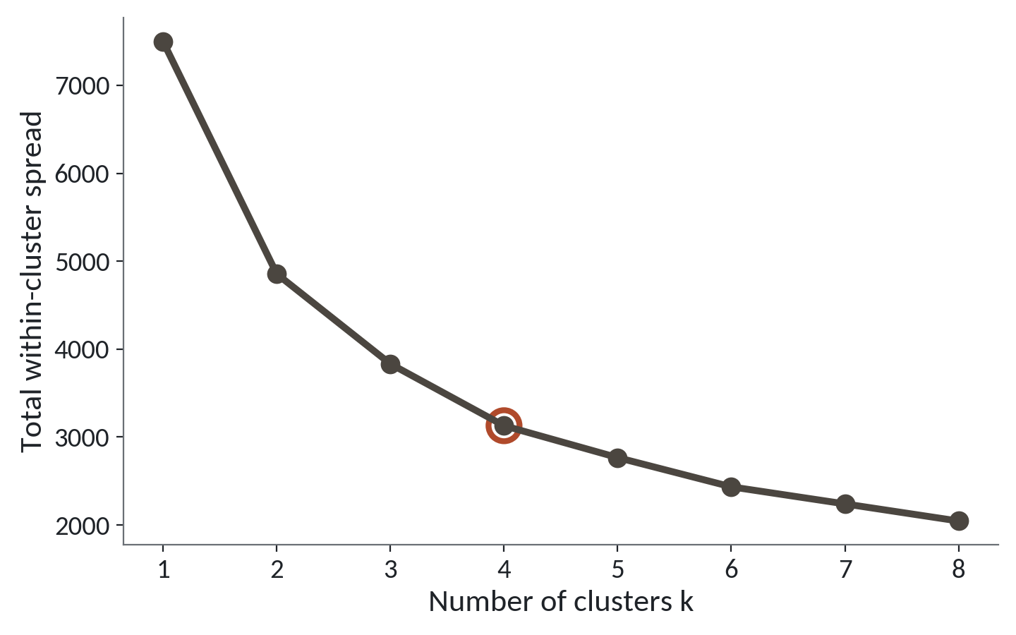
Choosing k: look for the bend
1
More groups always shrink the spread inside groups.
2
The big drops come early, then the line flattens.
3
A gentle bend appears around four, marked in red.
The elbow is a hint. Usefulness to the business also counts.
Session 18 Finding structure without labels
13
Notes:
How many groups should we ask for? This chart helps. For each k from one to eight, I ran k-means and measured how spread out the customers are inside their own groups. Smaller means tighter groups.
The first point is that the line only ever goes down. More groups always give tighter groups. With one group per customer the spread would be zero, and that would be useless. So we cannot just pick the lowest point.
The second point is where the picture helps. The line drops steeply from one to two, then to three, and then it flattens out.
The bend, called the elbow, sits around four. That's marked in red. Adding a fifth group buys much less than adding the fourth.
The bend is gentle, and two people could argue for three or five. The elbow is a hint. We also ask whether four groups are ones a manager can act on. Four is.

Slide 14
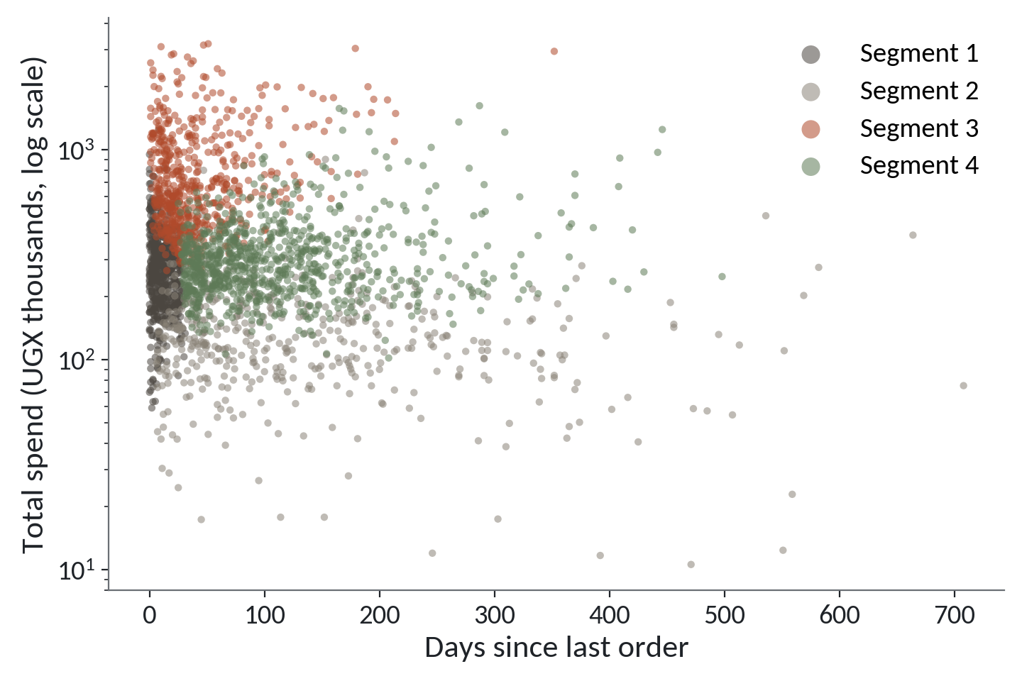
Four customer groups on recency and spend
1
Each dot is one customer. Spend is on a log scale.
2
Dark grey and red dots came recently. Red spent the most.
3
Light grey dots spent little. Green dots are in the middle on spend and have been away longer.
k-means with k = 4 on the loyalty customers.
Session 18 Finding structure without labels
14
Notes:
Here are the groups, drawn on two of the three columns. Days since the last order runs along the bottom. Total spend runs up the side, on a log scale so the big spenders do not squash everyone else.
Each dot is one customer. The colours are the four groups the method found, and nobody told it where the lines go.
Dark grey and red dots ordered recently, so they sit at the left. Red sits higher up, because those customers spend the most.
Light grey dots sit low, because those customers spent little, and many of them have been away a long time. Green dots sit in the middle on spend and further to the right. These are the customers drifting away.
The groups overlap at their edges, which is normal. Real customers do not fall into neat boxes. The method draws the best lines it can, and a customer near a line could have gone either way.

Slide 15
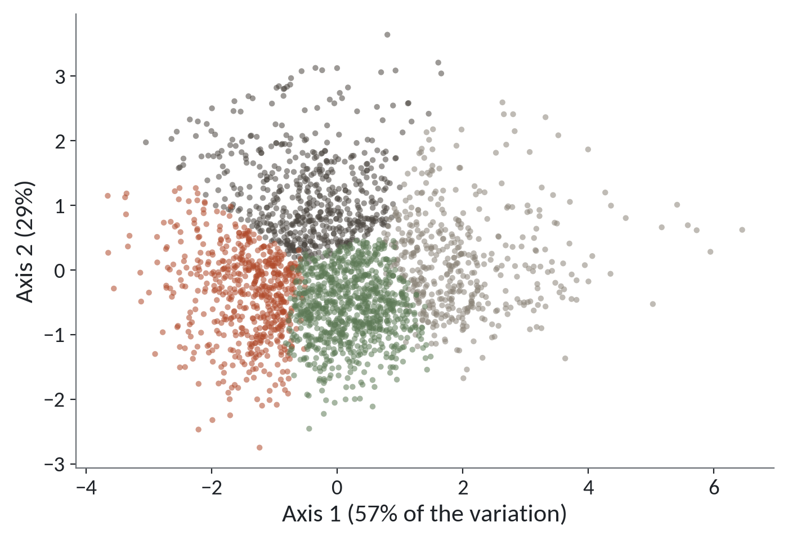
PCA: many columns, one flat picture
1
PCA mixes the three columns into two new axes.
2
The axes keep 57 and 29 percent of the variation.
3
The groups sit in separate regions that touch at the edges.
PCA is a picture for people. It does not change the groups.
Session 18 Finding structure without labels
15
Notes:
A screen is flat, so we can show two columns at a time. We have three, and a real customer file might have thirty. How do you draw that?
The answer is PCA, short for principal component analysis. It mixes the columns into two new axes that keep as much of the variation as possible. Think of photographing a statue. You choose the angle that shows the most of it.
The axis labels tell you how well the photograph does. The first axis keeps fifty seven percent of the variation, and the second keeps twenty nine. Together that is most of what the three columns hold.
The colours are the same four groups as before. They sit in clear regions, with some overlap at the edges. That tells us the groups are not an accident of one chart. It does not prove they are real, because k-means finds groups in any cloud of dots. PCA only draws the picture. It does not change the groups.

Slide 16
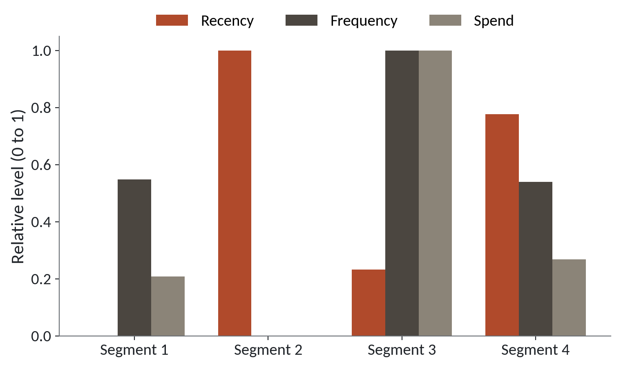
What each segment is like, in one chart
1
Segment 3 has the most orders and the most spend, and ordered recently.
2
Segment 2 has the longest gap and the lowest orders and spend.
3
Segments 1 and 4 sit in between, and differ in how recently they came.
Each bar is scaled 0 to 1 across segments, so the heights compare groups.
Session 18 Finding structure without labels
16
Notes:
To name a group you need to know what its customers are like. This chart gives the average recency, frequency and spend of each segment. Each is scaled from zero to one across the four groups, so you can compare heights.
Segment three has the tallest bars for orders and for spend. Those customers order the most and spend the most. Their red bar for recency is short, which is good, because short means they came recently.
Segment two is the opposite. Its red bar is the tallest, so it has the longest gap since the last order, and its other bars are the lowest.
Segments one and four sit in the middle. They look alike on orders. What separates them is the red bar. Segment one came recently, and segment four has been away much longer.
Now we can name them.

Slide 17
Naming each segment in business words
Name | Customers | Days since last order | Orders | Average spend (UGX) | Suggested action
Top spenders | 584 | 42 | 12 | 826,220 | Thank them, early access
Recent regulars | 570 | 11 | 8 | 284,683 | Encourage a bigger basket
Drifting regulars | 883 | 113 | 8 | 326,264 | Reminder before they lapse
Lapsed light buyers | 462 | 142 | 5 | 142,739 | Cheap win-back or leave
In a typical run. Your group numbers and exact counts will differ a little.
Session 18 Finding structure without labels
17
Notes:
Here's how a manager would read the four groups. These figures come from a typical run. Your own run in scikit-learn will give close numbers that differ a little, and your group numbers may come in a different order. Match groups by what they look like and ignore the number.
The top row is our best customers. About five hundred and eighty four of them, twelve orders each, spending about eight hundred and twenty six thousand shillings. I call them top spenders.
Recent regulars came in about eleven days ago. They buy often but spend a modest amount, so the chance is a bigger basket.
Drifting regulars are the biggest group, about eight hundred and eighty three. They used to order as often as the recent regulars, but it has been over a hundred days. A reminder now may bring them back before they are gone.
Lapsed light buyers have been quiet for about a hundred and forty days and spent least. Maybe a cheap offer, maybe leave them be.
The model found the groups. The names and the actions are your work.

Slide 18
The groups look neat, so people treat them as facts
What it looks like
Why it goes wrong
The fix
You run k-means, get four tidy groups with colours, and report that segment 2 is the best segment. Next week a colleague reruns it and segment 2 is now the weakest one.
k-means always returns k groups, even in data with no real groups. Its numbers are arbitrary labels, and a different start or a new month of orders can shuffle them.
Name groups by what they contain. Fix random_state, check sizes and averages each run, and test whether the groups help a decision.
Session 18 Finding structure without labels
18
Notes:
This trap runs with no error at all.
You run the model, and out come four tidy groups with colours. You tell the manager that segment two is your best segment. A week later a colleague reruns the notebook, and segment two is now the weakest group.
Nothing was wrong with the code. The number on a segment is only a label, and the method hands out labels in whatever order it finds the groups.
There is a deeper reason too. k-means will always give you the number of groups you ask for, even when the customers have no real groups in them. It never says there is nothing here.
So the fix is a set of habits. Name the groups by what the customers in them do, such as drifting regulars. Fix the random state and check the sizes and averages every time you rerun. And ask whether the groups change a decision. A segment nobody can act on is just a coloured chart.

Slide 19
Unusual orders with a simple rule: the top 1 percent
v = orders['order_value_ugx']
p99 = v.quantile(0.99)
big = orders[v > p99]
print('99th percentile:', round(p99), 'UGX')
print(len(big), 'orders above it')
print('median of all orders:', v.median())
print('median of flagged:', big['order_value_ugx'].median())
1
quantile(0.99) is the value that 99 percent of orders fall below.
2
The rule flags 303 orders. By design it always flags about 1 percent.
Output
99th percentile: 468620 UGX
303 orders above it
median of all orders: 23200.0
median of flagged: 829200.0
3
Flagged orders are a list for a person to review.
Session 18 Finding structure without labels
19
Notes:
The second job is spotting orders that look odd. An odd order is called an anomaly. It's a row that looks very different from the rest and deserves a human look.
The simplest rule is one you could do in a spreadsheet. Take the value that ninety nine percent of orders fall below, which is the ninety ninth percentile, and flag everything above it. Here that cutoff is four hundred and sixty eight thousand six hundred and twenty shillings.
That flags three hundred and three orders out of thirty thousand. This rule flags one percent of orders whatever the data looks like, because that is how it is built.
The median of all orders is twenty three thousand two hundred. The median of the flagged ones is over eight hundred thousand. The flagged orders are a different kind of order.
What do we do with the list? We review it. A big order could be a wedding catering job, a bulk buy for a school, or a keying mistake. We never delete it just because it is big.

Slide 20
IsolationForest flags customers who look strange as a whole
from sklearn.ensemble import IsolationForest
iso = IsolationForest(contamination=0.01, random_state=42)
rfm['odd'] = iso.fit_predict(X)
odd_customers = rfm[rfm['odd'] == -1]
print(len(odd_customers), 'customers flagged')
1
contamination is the share you expect to be odd. One percent is a guess you choose.
2
fit_predict gives -1 for odd rows and 1 for normal rows.
3
It looks at all three columns together.
Session 18 Finding structure without labels
20
Notes:
The percentile rule looks at one column. Sometimes a customer is odd only because of the combination. Plenty of orders but tiny spend, for instance. IsolationForest looks at all the columns together.
The idea is easy to say. It builds random trees that cut the data into pieces. A normal customer needs many cuts before they are alone in a piece. A strange customer is cut off after just a few. Fewer cuts means stranger.
The contamination setting is how much of the data you expect to be odd. We say one percent, which is a number we choose, so it is a guess about our own business. On our customers it should flag about twenty five.
fit_predict gives minus one for the odd rows and one for the normal rows. We keep the minus ones in a table and count them. As before, the result is a list for people to check. It does not decide anything.

Slide 21
Lab: segment the Lakeside customers
1
Open the Session 18 notebook and run the setup cell
Tool and time
Google Colab
40 minutes
2
Keep loyalty orders, then build recency, frequency and spend
3
Log and scale the columns
You are done when
4
Run k-means with k = 4
Your table has 2,499 customers, four groups, and a business name and action for each.
5
Draw the elbow chart and profile the groups
6
Flag the top 1 percent of orders
7
Name each segment in a markdown cell
Session 18 Finding structure without labels
21
Notes:
The first task is to keep only the orders that name a customer. Open the Session 18 notebook, run the setup cell and start there. It's forty minutes in Google Colab.
The next tasks build recency, frequency and spend, then log and scale them. Their checks tell you straight away if your counts are right. The k-means task and the elbow chart use scikit-learn, and their checks allow a range, because your groups will land close to mine and differ a little.
The last task is the part no model can write for you. Give each segment a name in business words and one line on what you would do for them. The group numbers can change between runs, so describe the customers.

Slide 22
Questions to finish
1
Why are walk-in orders left out of the customer segments?
They have no customer_id, so we cannot add up one person's orders. Say this when you report.
2
Why log and scale the columns before k-means?
Spend is skewed and its numbers are huge. Without the steps, spend would decide every distance.
3
Your colleague's rerun shows segment 2 as the weakest. What went wrong?
Nothing. Group numbers are arbitrary labels. Name groups by what the customers do.
Session 18 Finding structure without labels
22
Notes:
Walk-in orders, log and scale, and a rerun that changed the segment numbers. Three questions on those.
Question one. Why are walk-in orders left out of the customer segments? Sit with it for a second.
They have no customer id. Without it we cannot add up one person's orders into recency, frequency and spend. And when you report, you say that walk-ins are not in the groups.
Question two. Why do we log and scale the columns before k-means? Think it over.
Spend is skewed, with a few huge values, and its numbers are far larger than the others. Without the log and the scaling, spend would decide every distance and the other columns would barely count.
Question three. A colleague reruns the notebook and segment two now looks like the weakest group. What went wrong? Give that a moment.
Nothing went wrong. The numbers are only labels, handed out in whatever order the groups are found. That's why we name groups by what their customers do.

Slide 23
Summary
Without an answer column, we look for structure: RFM features, logged and scaled, then k-means.
Choose k with the elbow and with usefulness. PCA draws the groups flat for people.
Name each segment in business words. Flag anomalies and review them. Never delete them just for being big.
Next session. Forecasting and a first end-to-end model
Session 18 Finding structure without labels
23
Notes:
One. With no answer column, we look for structure. We turn each customer into three numbers, recency, frequency and spend, log the skewed ones, scale them all, and let k-means find the groups.
Two. We choose k with the elbow chart and with common sense about what a manager can use. PCA draws the groups on a flat picture so people can see them.
Three. The groups get their names from you, in business words. Odd orders and odd customers go on a list for review. Big does not mean wrong.
Next session we forecast. We predict next month's numbers, and we package a whole modelling job from start to finish, which is also Checkpoint 3. Bring your best questions about time and seasons.

